Slide 1
Objects
10 minute oyster

Slide 2
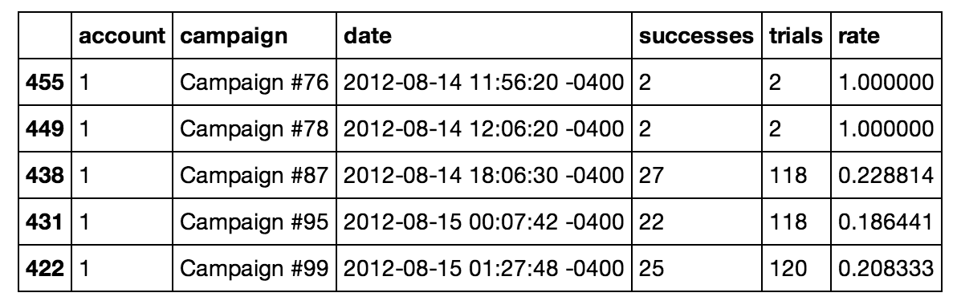
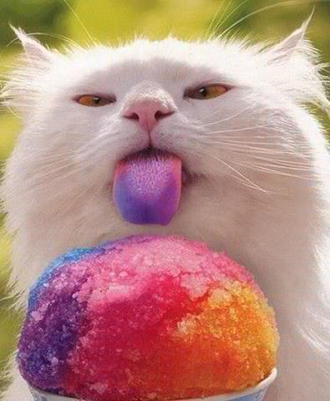
Objects
What happens when we type 7 into the python prompt? Or “text”?
7 and “text” are examples of Python objects.
Object sounds like a rather general term – and it is. An object is basically a container for data.
When you type in 7, Python creates an object to store the data in 7 (just a little data)
Why is this important?
At a low level, all data is stored as a bunch of zeros and ones in memory
The data for 7 has to be kept separate from the data for Bill,
Our customer records must be kept separate from our company logo, etc…
Objects ensure that we keep these things separate.
Here’s a depiction of an object space – all the objects you can access.
You can see several types of data, all kept separate.
You can think of objects as containers that can hold any type of data.
Surprisingly, even the code you write is held in objects.
Object Space
in Memory
1.5
print(“Hello world!”)
Sales in the third quarter were higher than expected…

Slide 3
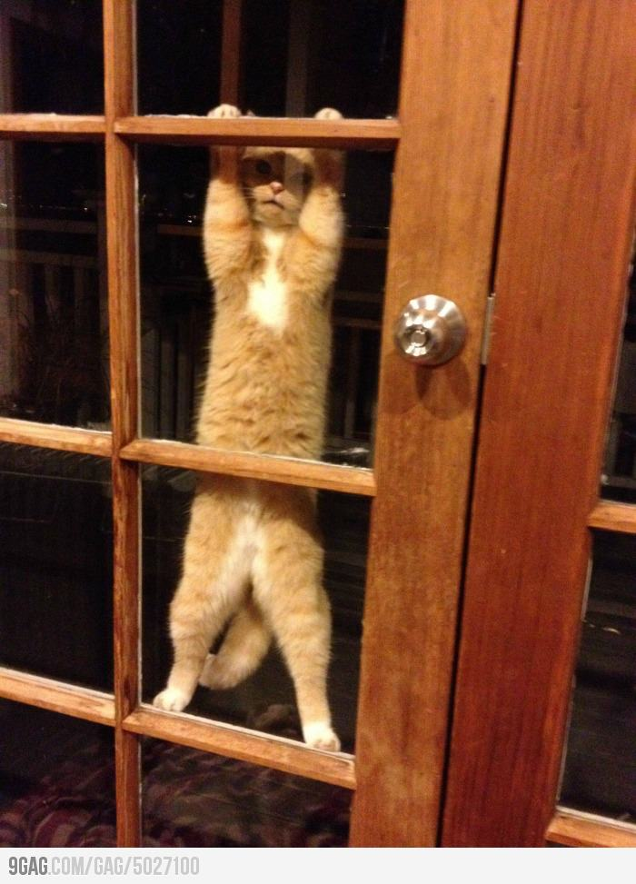
Types
Object Space
36
7
int
int
print(“Hello world!”)
function
file
You can think about a program as instructions to manipulate objects
In computer memory, all objects are stored as zeros and ones.
You wouldn’t be able to look at the 0’s and 1’s and tell a table of customer data apart from a photo.
But of course, the types of things you can do to a data table are very different than those you can do to a photo.
For this reason, we need to keep track of what type of data is in each object.
To do this, each object in Python has a type.
We can call it a type or a class – these are essentially interchangable in Python 3.
In this object space, you can see that 36 is of type int – so we know it holds an integer. The print line is of type function, so we know that it’s something we can run.

Slide 4
Strongly-typed languages
Python is strongly-typed: That means that it will restrict the operations you can perform, based on an object’s type.
You can add two integers together, but not two functions.
This makes it safer to program in. It keeps you from making some mistakes.
In a weakly-typed language, the computer will let you do things like add functions together – but the result probably won’t make any sense and it may be hard for you to figure out why your functions don’t work.

